Slide 1
Demand views

Slide 2
Contents
Data logs
Why DV logs
Aggregate Views
Contents of view
Getting data

Slide 3
Data logs
Data Logs
Performance
Inventory
Others
M*
SA
RnR
MV
RICH
ODP
C2C
Demand Views
Campaign DB
NIF
RnR Logs
JointObject
IE
COM SCORE

Slide 4
Why DV logs?
To get the inventory level data
Track the changes in the bid or keywords
To analyze the ad’s eligibility

Slide 5
Aggregate views
Demand View
Account
Campaign
Order
Listing
API Tool Provider
Each entry under demand view represents different aggregate views
Each aggregate view contains the details at that level
e.g., Campaign Aggregate View holds the details at campaign level

Slide 6
Contents of views
Listing
Order
Customer
Account
Campaign
The account view contains the account details with customer details as well at account level
Campaign view has the campaign details along with Account details and Customer details
Order View comprises of the details of the order along with the campaign, account and customer details.
Listing view encompasses details of all at the listing level
Order
Campaign
Account
Customer

Slide 7
Account Aggregates View
Account level data
Fields
Account Id, Name, Type
Account Active and Lifecycle status
Eligible and servable accounts
Payment details
Count of eligible , servable, active and total campaigns
It also contains customer details

Slide 8
Campaign Aggregates View
Campaign level data
Fields
Id, Name
Campaign Duration, Status
Budget details and modifications
Eligible and servable campaigns
Extension and targeting details
Conversion tracking
Bid details with modification
Count of eligible , servable, active and total orders
It also contains Account and Customer details

Slide 9
Order Aggregates View
Order Level data
Fields
Order Id, Ad Id
Order status
Medium Id
Start and End date
Bid changes details
Eligible and servable orders
Count of eligible , servable, active and total listings
It also contains the customer , account and campaign details

Slide 10
Listing Aggregates View
Listing(Order Item) level data
Fields
Listing Id
Status
Keywords details
Placeholder details(Param)
Listing eligible ,servable
Match type and bid details
Bid modification details
Count of match type bid changes and total bid changes
They also contain customer , account, campaign and order details

Slide 11
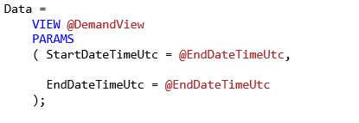
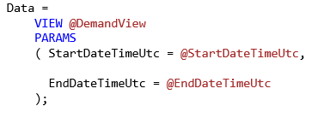
Getting data
At a point of time - Snapshot
Passing the start date and end date parameter as the same value
Example
Modifications – Range
Specifying different dates in start and end date i.e., a range in which we are looking
Example
Same start and end datetime

Slide 12
For your reference
Demand View Data dictionary
Demand View Base Script - Sample

Slide 13
Assess yourself…
Name the column, aggregate view and the mode of getting data:
Find the count of the eligible and ineligible listings of retails for June 2016
For the customer Walmart, check how many targeting features were adopted during Christmas 2015
Enlist the inactive accounts which have the bids modified for more than 20 times in Jan 2016
Find the orders which have accommodated only phrase and exact match type and were found active for the past two months
Find out how many times the campaign has been paused for the customer Toyota in a month in the last year

